Slide 1
Employee Performance Analysis Using Excel
PRESENTED BY: SURENDAR G
REGISTER NO.: 312204536
DEPARTMENT: COMMERCE
COLLEGE: K.C.S KASI NADAR COLLEGE OF ARTS AND SCIENCE

Slide 2
PROJECT TITLE
Employee Performance Analysis Using Excel

Slide 3
AGENDA
1.Problem Statement
2. Project Overview
3.End Users
4.Our Solution and Proposition
5. Dataset Description
6. Modelling Approach
7. Results and Discussion
8.Conclusion

Slide 4
PROBLEM STATEMENT
1. Imbalanced Ratings in Departments
2. Rating Discrepancies within Pay Zones
3. Departmental Distribution and Size
4. Employee Development Needs
5. Employee Satisfaction and Retention Risk

Slide 5
PROJECT OVERVIEW
[Employee Performance Improvement and Pay Zone Optimization]
Employee Attrition Analysis Using Excel Dashboards
Creating an Employee Performance Scorecard in Excel
Using Pivot Tables for Employee Turnover Analysis
Visualizing Employee Attendance Trends with Excel Charts
Salary and Compensation Analysis Through Excel Data Modeling
Data Manipulation Techniques, Conditional Formatting, Pivot Table, Functions and Formulas, Power Query, Charts and Graphs

Slide 6
WHO ARE THE END USERS?
Human Resources (HR) Department
Department Managers (Sales & Production)
Senior Leadership/Executives
Employees
Finance/Compensation Teams

Slide 7
OUR SOLUTION AND ITS VALUE PROPOSITION
Filtering - Remove missing values.
Conditional Formatting - Blanks, Background Color Shading, Data Bars, Values.
Data Filtering and Sorting - Identify specific employee groups, such as those with exceeds, needs improvements and fully meets.
Pivot table - Summary of employee performance under their current rating .
Graphs - FINAL REPORT.

Slide 8
DATASET DESCRIPTION
EMPLOYEE ID: Unique identifier for each employee in the organization.
FIRST NAME: The first name of the employee.
PAY ZONE: The pay zone or salary band to which the employee's compensation falls.
DEPARTMENT TYPE: The broader category or type of department the employee's work is associated with.
CURRENT EMPLOYEE RATING: The current rating or evaluation of the employee's overall performance.

Slide 9
MODELLING
DATA SET: Kaggle, Employee dataset.
FEATURE SELECTION: Slicer, Conditional Formatting, Designing.
DATA CLEANING: Missing values, Irrelevant data, Correct Errors, Remove Unnecessary Columns and Rows.
PIVOT TABLE: Employee ID, First Name, Pay zone, Department Type, Current Employee Rating.
CHART: Report of Employee Performance based on their Employee Id is represent in Values and Performance Score presented as Column Chart..

Slide 10

RESULTS

Slide 11

CONCLUSION
The project focuses on improving employee performance and aligning compensation through data analysis and strategic interventions. Using Excel as a primary tool provides an accessible, cost-effective, and flexible solution for analyzing employee performance, Pay Zones, and departmental efficiency.
By identifying performance gaps, creating targeted improvement plans, and adjusting compensation strategies, the company can:
Boost overall productivity.
Increase employee satisfaction and retention.-
Ensure fair and equitable compensation across Pay Zones.
Excel's powerful data analysis, visualization, and scenario planning capabilities enable real-time tracking, informed decision-making, and clear communication of insights to stakeholders. This solution offers a comprehensive approach to enhancing workforce performance and aligning it with organizational goals.

Slide 12
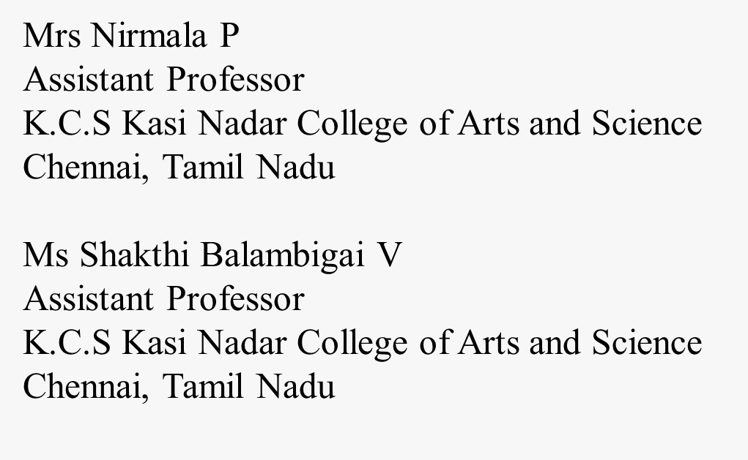
REFERENCE

